Slide 1


Slide 2
Introduction to Data Entities
Peter Prokopecz

Slide 3
Speaker Introduction
Peter Prokopecz
AX technical lead @ JJ Food Service Ltd. (Food wholesale)
Owner @ DAXVision ERP Consulting Ltd. (Your external AX tech. team)
http://www.daxvisionerp.com/
info@daxvisionerp.com
Studies: IT engineer (2006) + MBA (2019)
Experience: AX from 2003 – Trade and logistics, Developing, Technical architect
Lived in: Budapest (Hungary), Dubai (UAE), Cambridge (UK), Gent (Belgium)

Slide 4
Agenda
Data entity overview
Data management
Entity demo
OData
Composite data entity
Lessons learned
Azure Data Lake

Slide 5
DATA ENTITY OVERVIEW

Slide 6
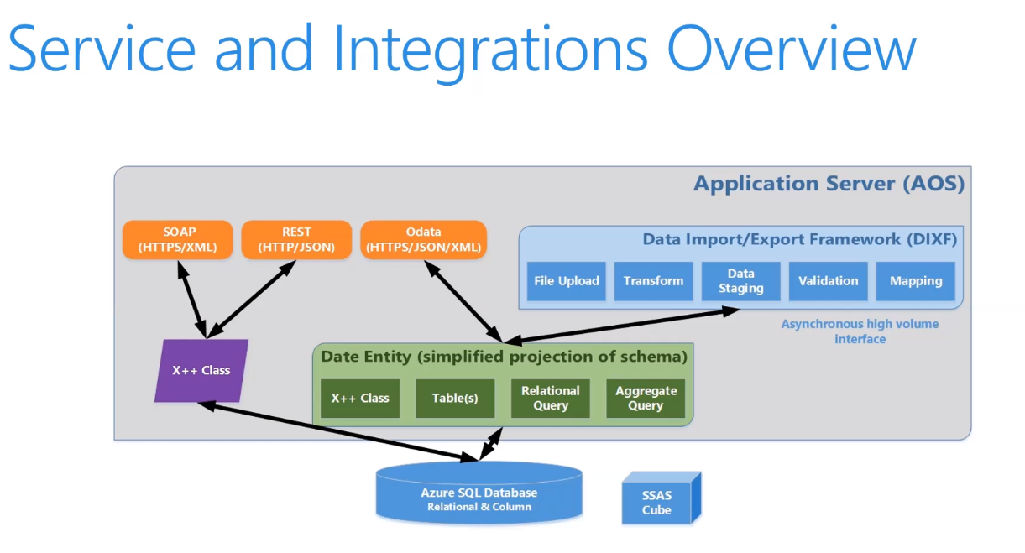
Services and integration
+ Azure Data Lake storage gen2!

Slide 7
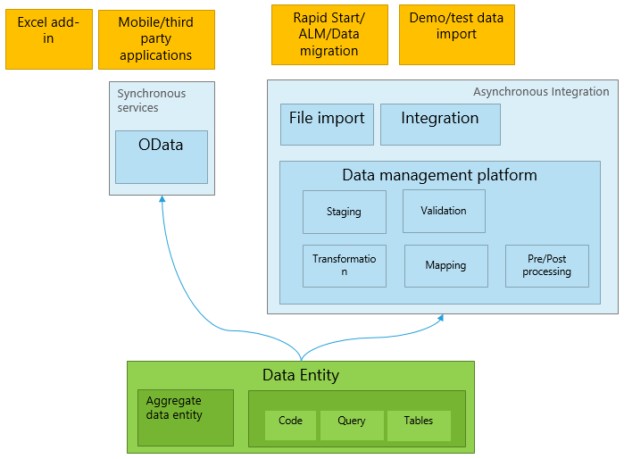
Data entity overview
DMF->DIXF->D365 Data Entity
http://daxvisionerp.com/call-ax-data-entity-from-postman/
http://daxvisionerp.com/excels-query-from-odata-feed-to-access-your-data-entity/
Notes:
2 min

Slide 8
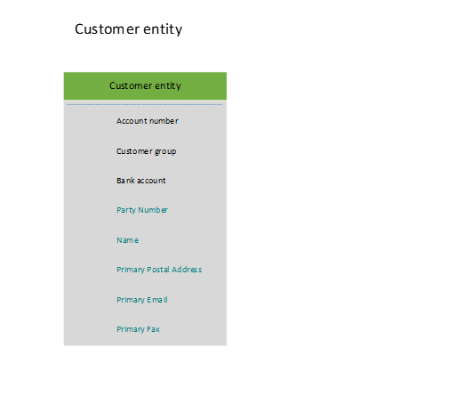
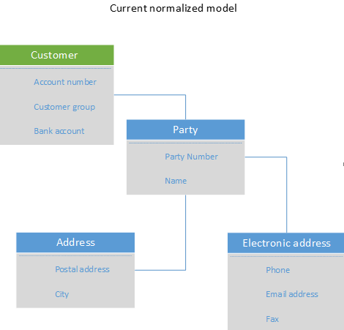
Data entity overview
Normalization – Redundancy/dependency
I NF-> II NF -> II NF structured process
Notes:
2 min

Slide 9
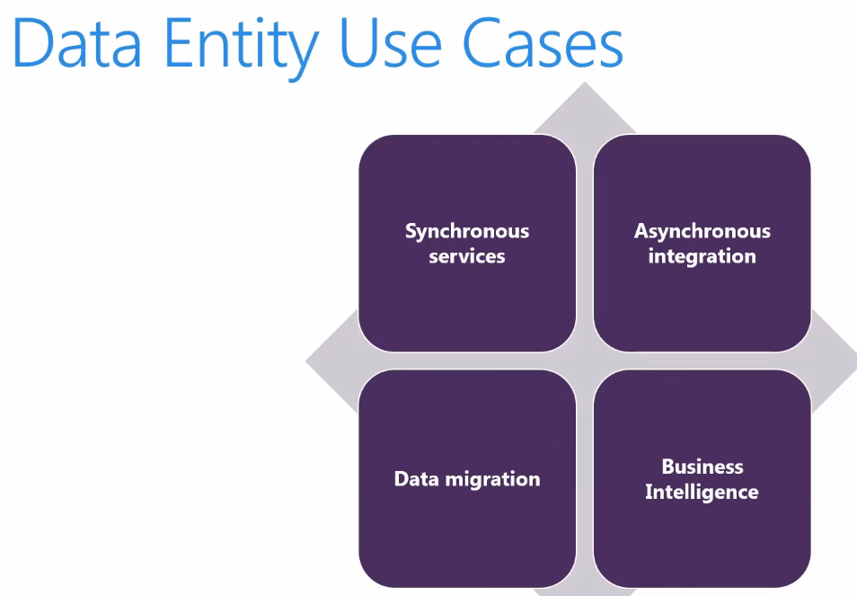
(Azure Data Lake!)

Slide 10
DATA MANAGEMENT

Slide 11
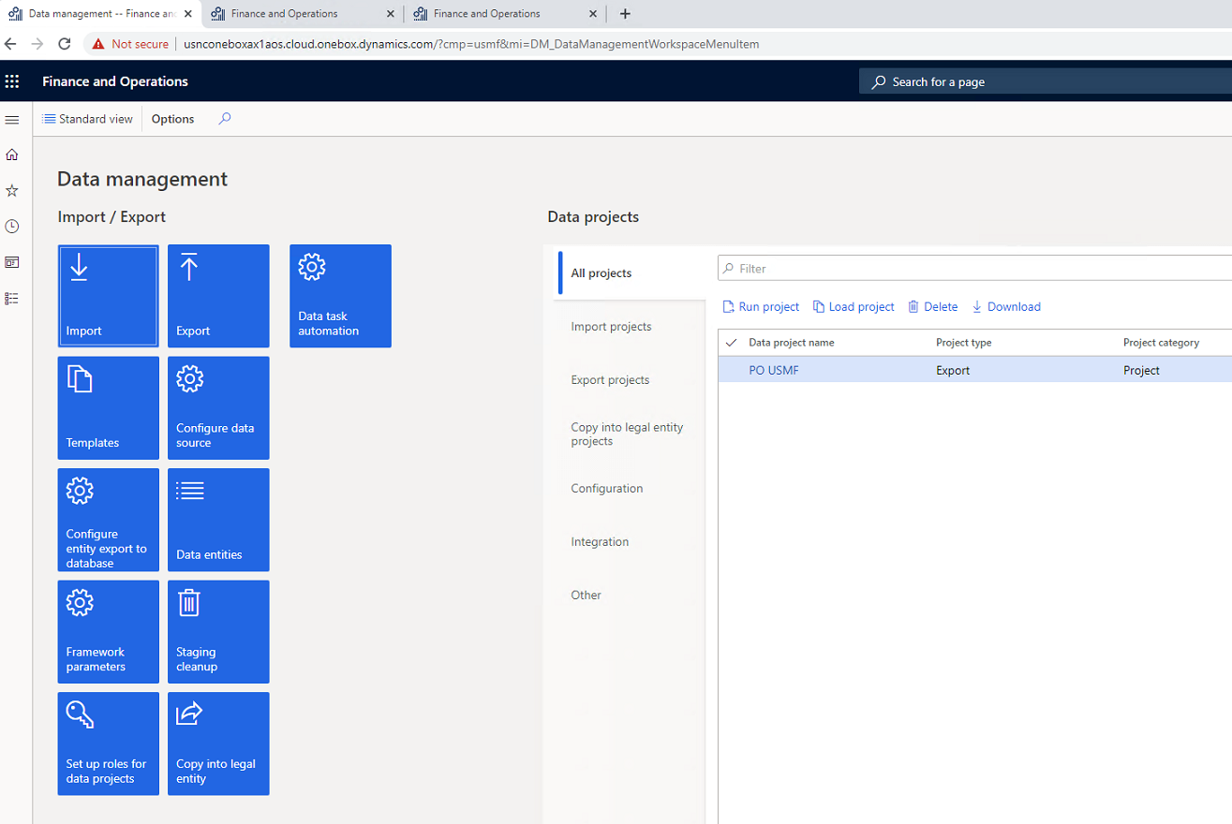
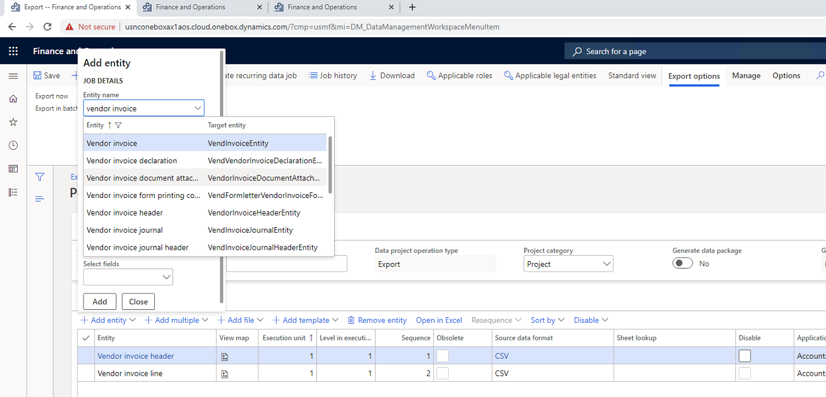
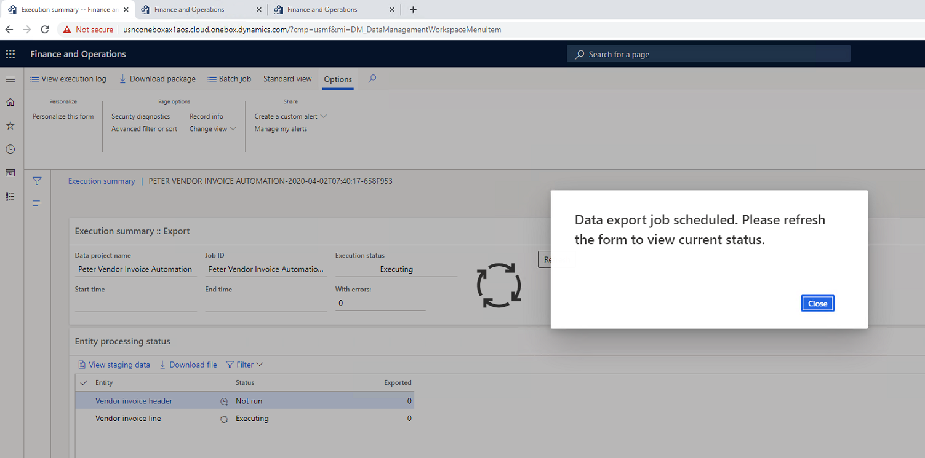
Data management UI

Slide 12
Vendor invoice automation
Accounts payables > Invoices > Pending vendor invoices
Vendor invoice header
Vendor invoice line
Vendor invoice document attachment
https://docs.microsoft.com/en-us/dynamics365/finance/accounts-payable/vendor-invoice-automation

Slide 13

Demo
Data management

Slide 14
DATA ENTITY DEVELOPMENT

Slide 15
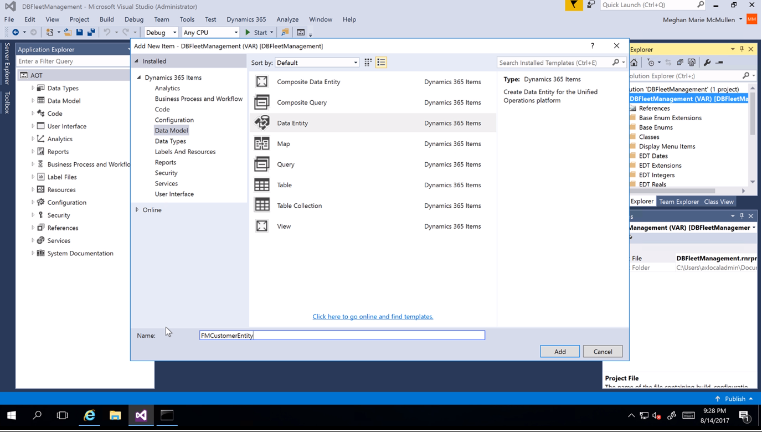
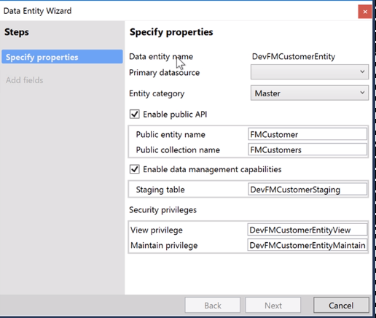
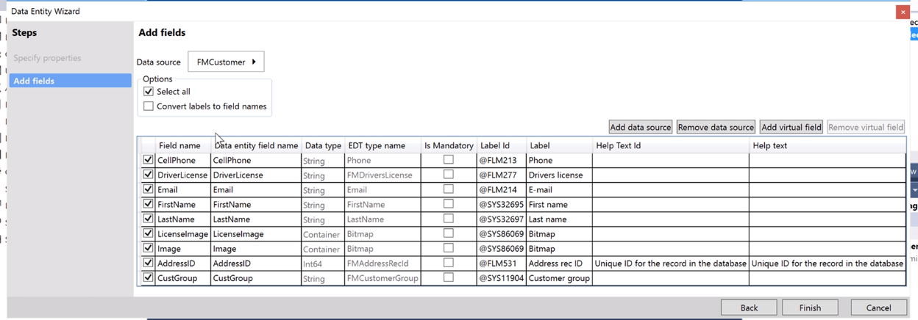
Creating Data entities

Slide 16
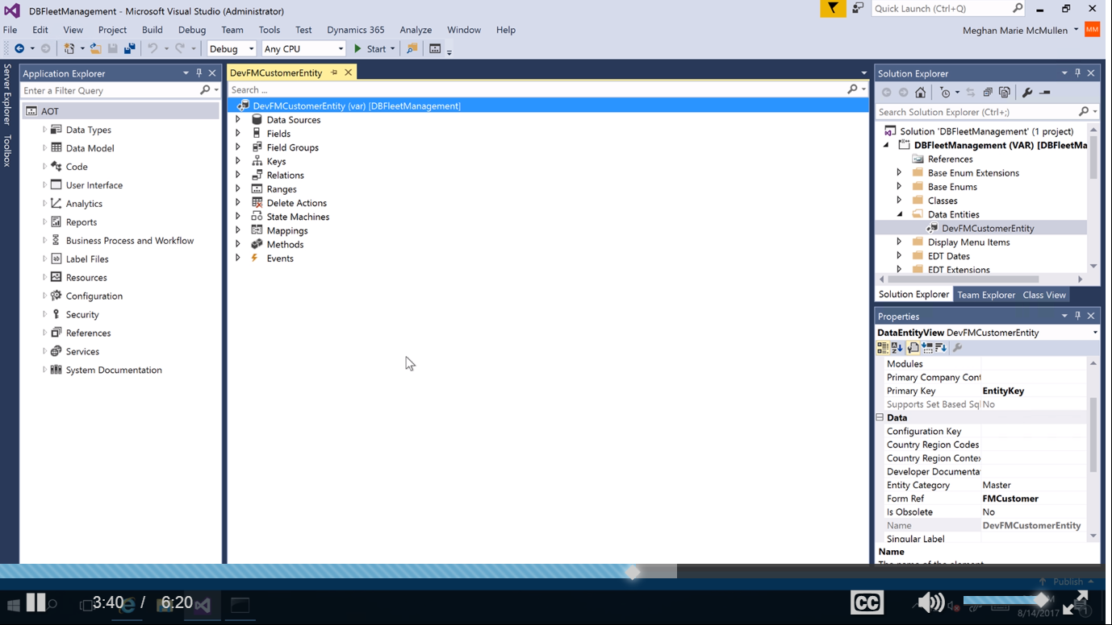
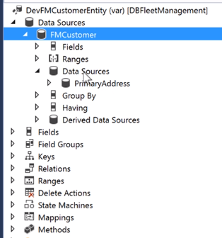
Data entity in AOT

Slide 17
DEV
Naming: <prefix><ConceptualName>Entity
Entity&view
Easiest test: runnable class, x++ select

Slide 18
Demo
Data entity development

Slide 19
Unmapped field types
Computed
T-SQL – new field added to the SQL View
Faster, more complicated to develope
http://daxvisionerp.com/view-computed-column-using-replace/
Virtual
X++ code (postLoad method) – similar to display methods on tables
Executed record by record
Computed column is better to use if possible because of better performance!
https://docs.microsoft.com/en-us/dynamics365/fin-ops-core/dev-itpro/data-entities/data-entity-computed-columns-virtual-fields

Slide 20
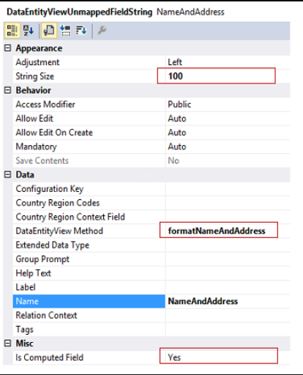
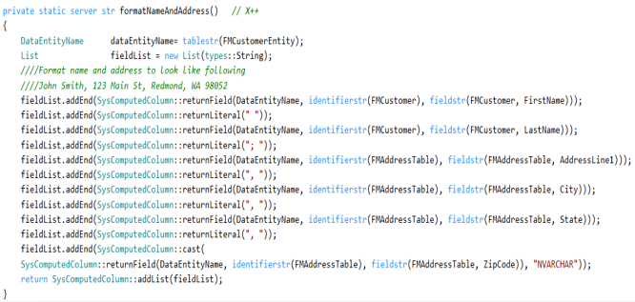
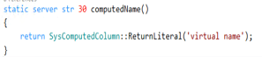
Computed

Slide 21
Demo
Computed column

Slide 22
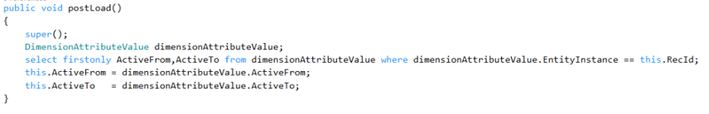
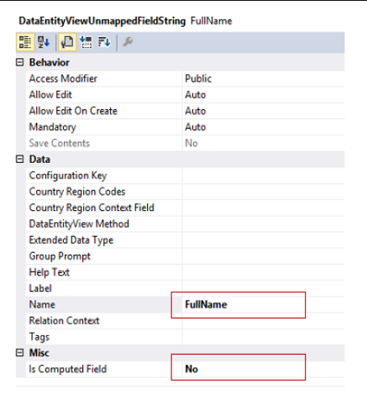
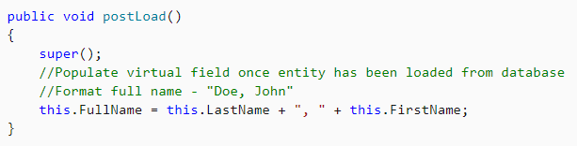
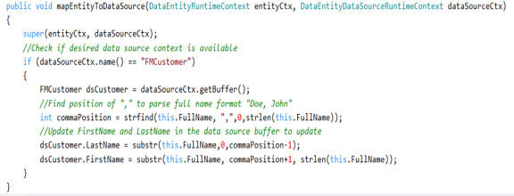
Virtual field

Slide 23
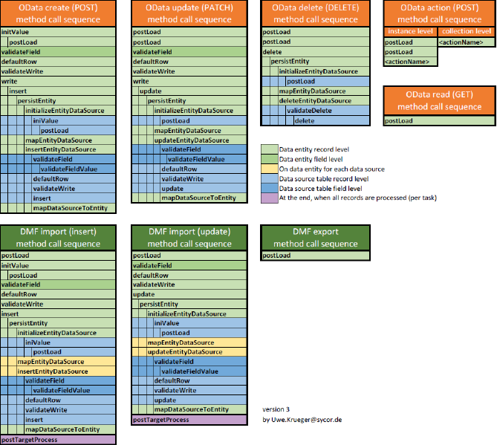
Method sequence

Slide 24
ODATA

Slide 25
Services and integration

Slide 26
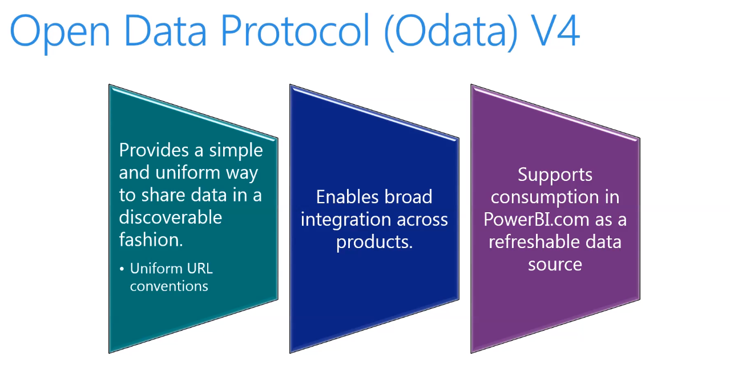
ODATA
Not for data migration

Slide 27
- $filter - $count - $orderby - $skip - $top - $expand - $select
ODATA – v4.0 query options

Slide 28
Odata query
URL | Description
[Your organization's root URL]/data/Customers | List all the customers.
[Your organization's root URL]/data/Customers?$top=3 | List the first three records.
[Your organization's root URL]/data/Customers?$select=FirstName,LastName | List all the customers, but show only the first name and last name properties.
[Your organization's root URL]/data/Customers?$format=json | List all the customers in a JSON format that can be used to interact with JavaScript clients.

Slide 29
Demo
OData browser and Excel

Slide 30
Test OData
http://daxvisionerp.com/call-ax-data-entity-from-postman/
http://daxvisionerp.com/excels-query-from-odata-feed-to-access-your-data-entity/
Notes:
2 min

Slide 31
Demo
OData Postman

Slide 32
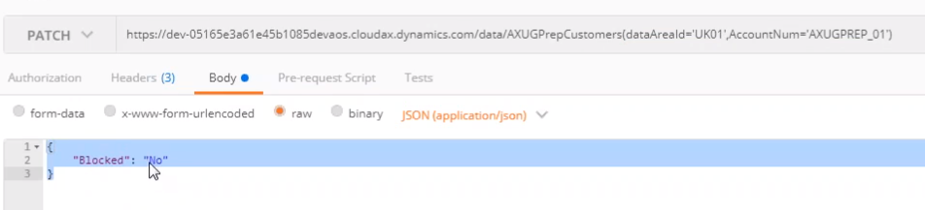
Update
Reference: AXUG Webinar, Cruz Margaix, How to develop your OData endpoints (Downloaded: 1.4.2020)

Slide 33
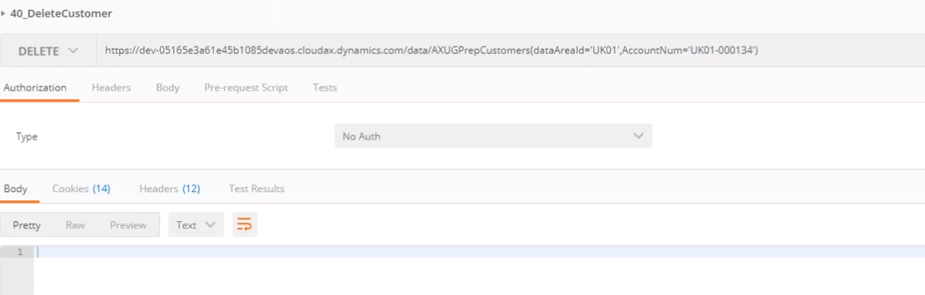
Delete
Reference: AXUG Webinar, Cruz Margaix, How to develop your OData endpoints (Downloaded: 1.4.2020)

Slide 34
Odata Enum
Enums namespace: Microsoft.Dynamics.DataEntities.
Enum syntax:
Microsoft.Dynamics.DataEntities.Gender'Unknown'
Microsoft.Dynamics.DataEntities.NoYes'Yes’
Enum usage example(‚eq’ and ‚ne’ can be used) :
https://environment.cloud.onebox.dynamics.com/data/CustomersV3?\$filter=PersonGender eq Microsoft.Dynamics.DataEntities.Gender'Unknown'
https://environment.cloud.onebox.dynamics.com/data/Currencies?\$filter=ReferenceCurrencyForTriangulation eq Microsoft.Dynamics.DataEntities.NoYes'No'

Slide 35
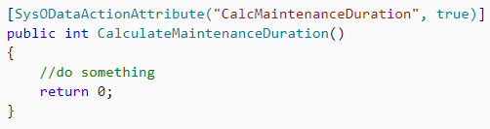
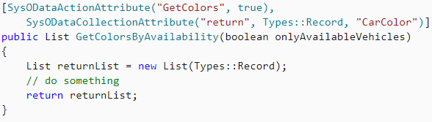
Odata Action
Adding business logic to Odata entity

Slide 36
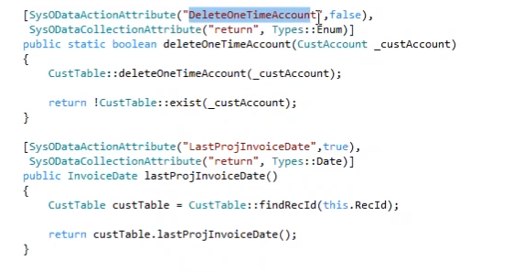
Odata action
Reference: AXUG Webinar, Cruz Margaix, How to develop your OData endpoints (Downloaded: 1.4.2020)

Slide 37
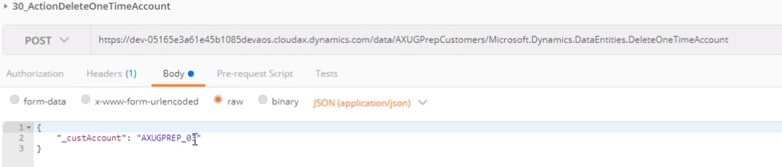
Odata action
Reference: AXUG Webinar, Cruz Margaix, How to develop your OData endpoints (Downloaded: 1.4.2020)

Slide 38
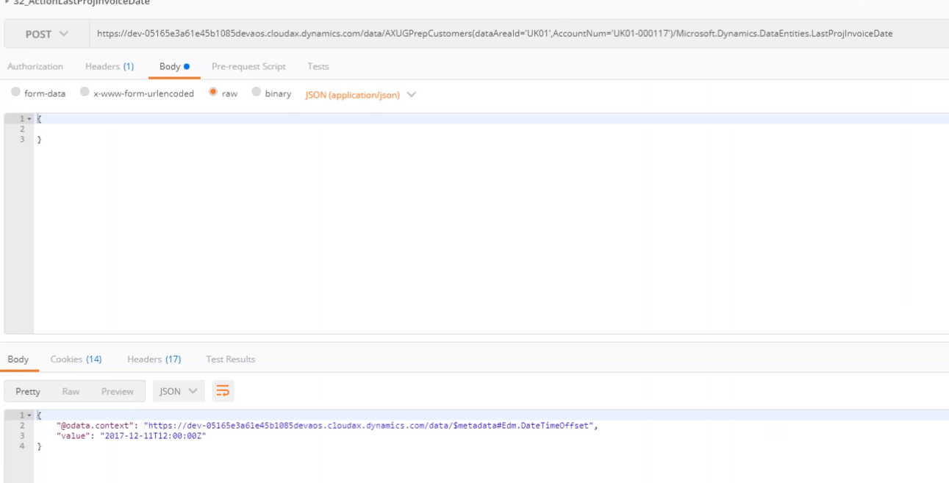
Odata action
Reference: AXUG Webinar, Cruz Margaix, How to develop your OData endpoints (Downloaded: 1.4.2020)

Slide 39
COMPOSITE DATA ENTITY

Slide 40
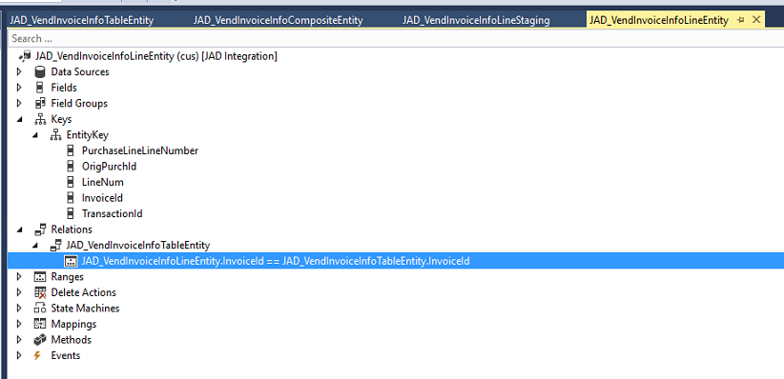
Line entity: add relation to header

Slide 41
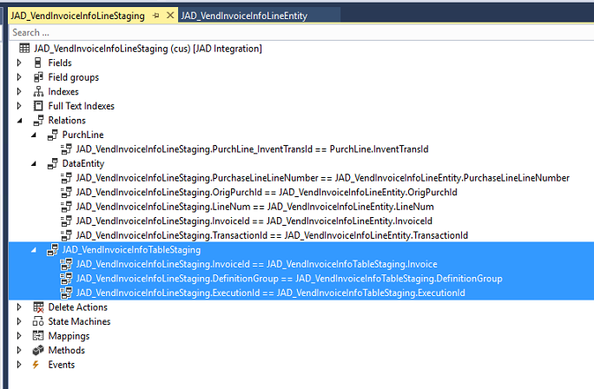
Line staging: add relation (include system added 2 fields)

Slide 42
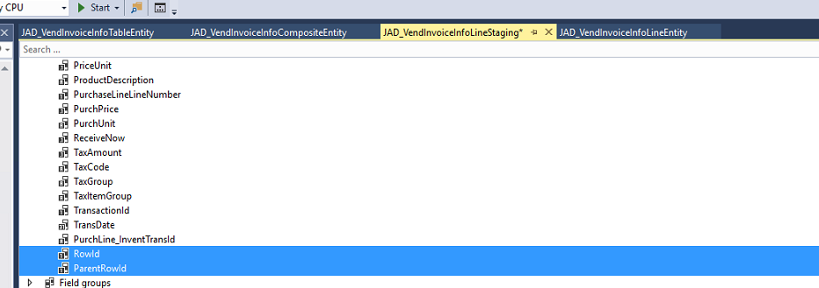
Line and Header staging: add rowId fields and index

Slide 43
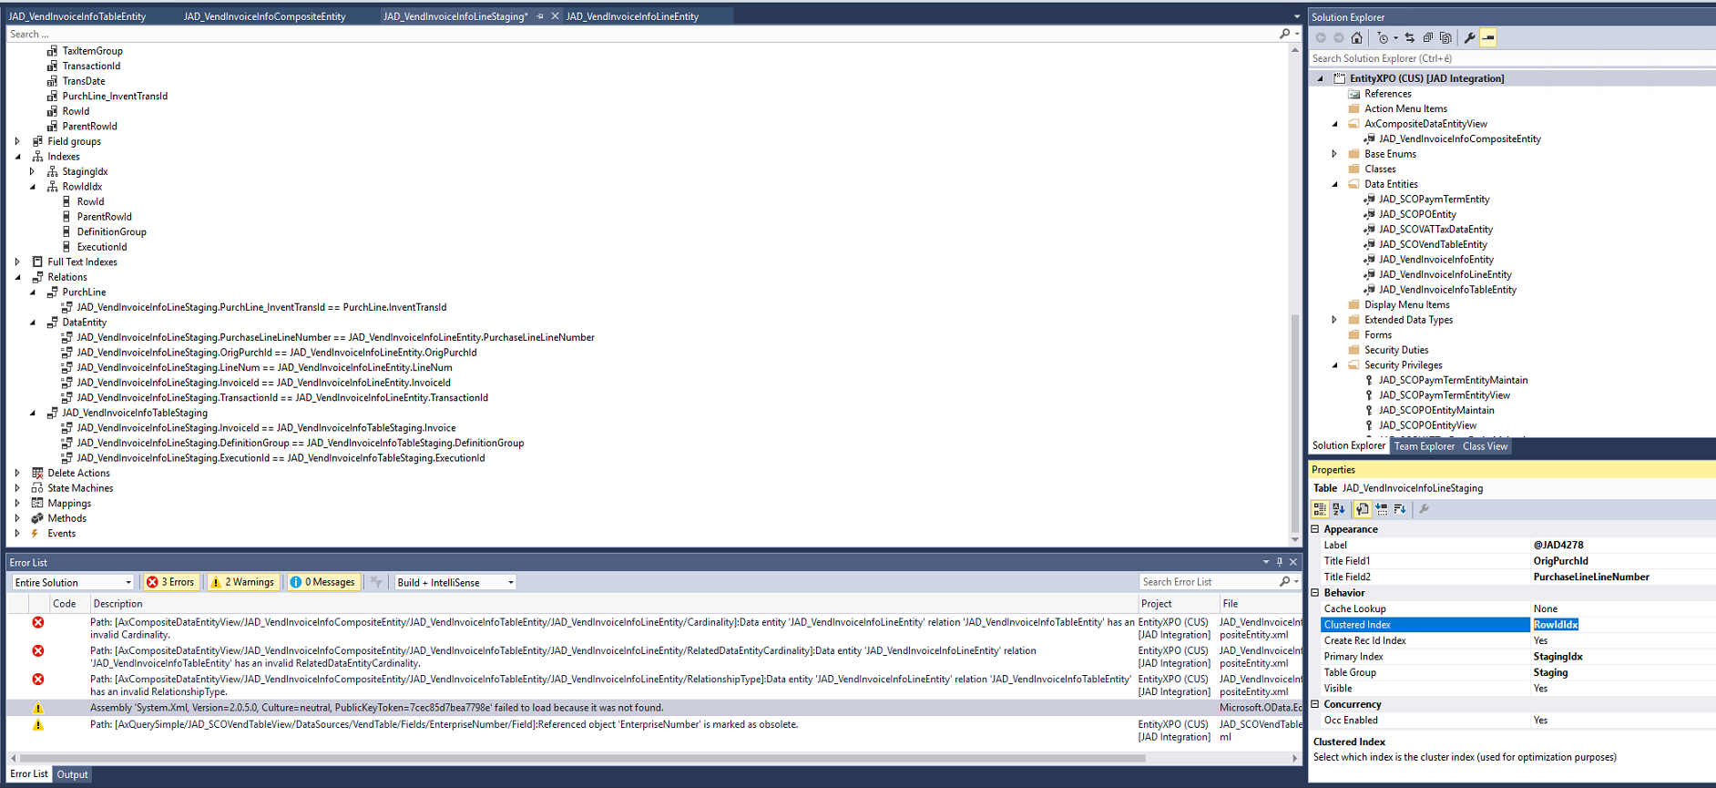
Line and Header staging: add rowId fields and index

Slide 44
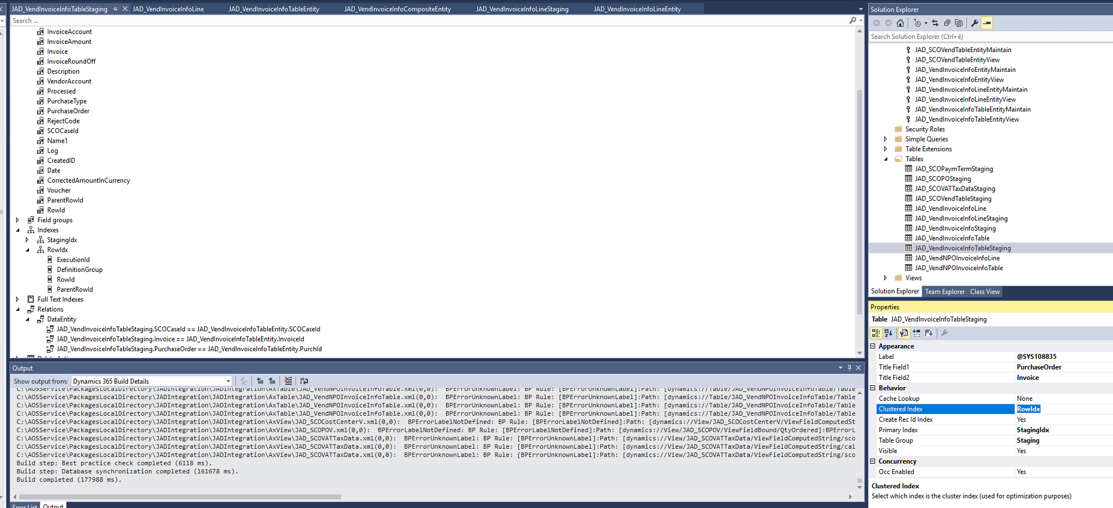
Line and Header staging: add rowId fields and index

Slide 45
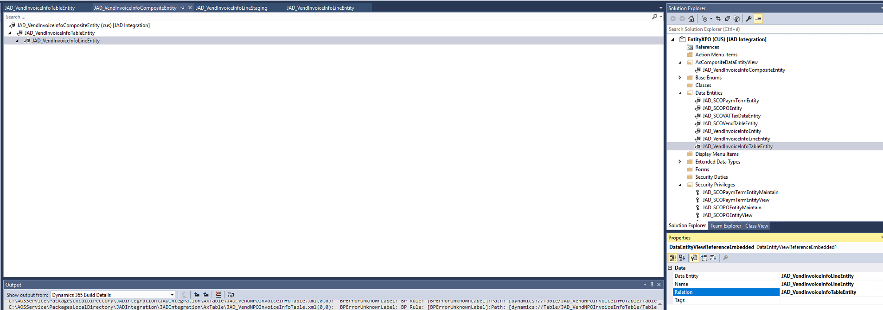
Create composite entity with relation

Slide 46
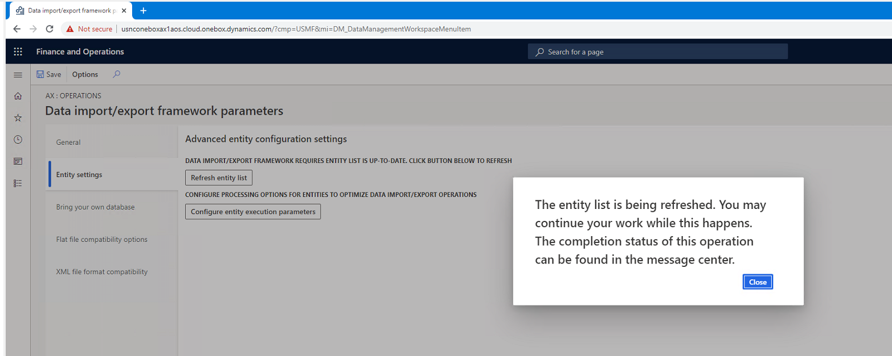
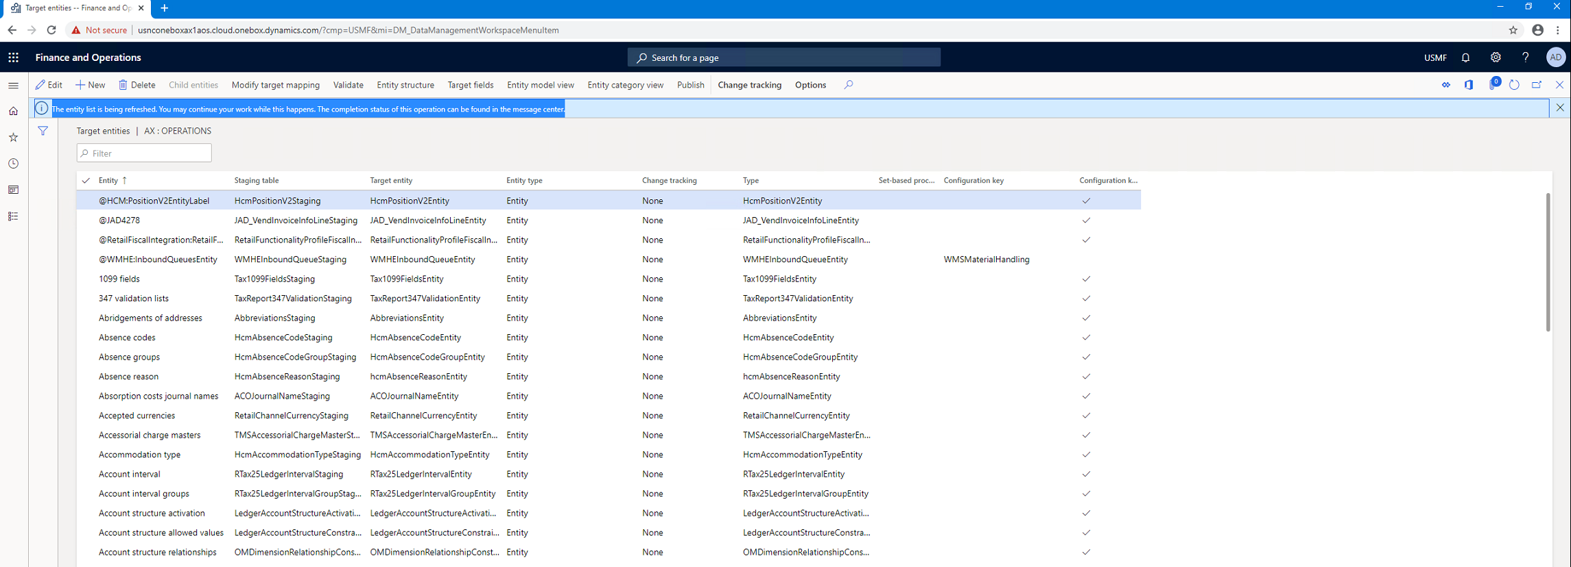
Refresh entity list

Slide 47
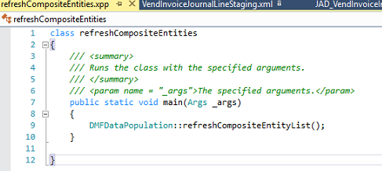
Alternative refresh
class refreshCompositeEntities
{
/// <summary>
/// Runs the class with the specified arguments.
/// </summary>
/// <param name = "_args">The specified arguments.</param>
public static void main(Args _args)
{
DMFDataPopulation::refreshCompositeEntityList();
}
}

Slide 48
LESSONS LEARNED

Slide 49
Lessons learned
„Given the large number of issues reported that end up being mitigated by cleaning up the execution history and staging table data and coupled with the fact that, the clean up jobs are not scheduled in most of the cases, we wanted to reach out and ask for your input on this topic.”
Microsoft is working on improvement of the cleanup jobs based on experience of early adopters.

Slide 50
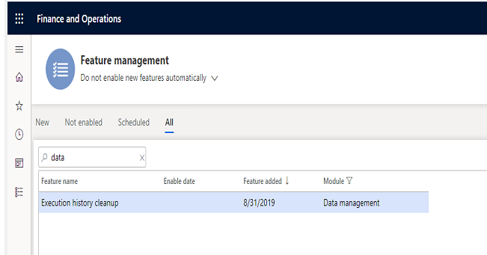
Lessons learned – data cleanup
Job history clean up (from Platform update 29)
The job history clean-up functionality in data management must be used to schedule a periodic cleanup of the execution history. This functionality replaces the previous staging table clean-up functionality, which is now deprecated. The following tables will be cleaned up by the clean-up process.
All staging tables
DMFSTAGINGVALIDATIONLOG
DMFSTAGINGEXECUTIONERRORS
DMFSTAGINGLOGDETAIL
DMFSTAGINGLOG
DMFDEFINITIONGROUPEXECUTIONHISTORY
DMFEXECUTION
DMFDEFINITIONGROUPEXECUTION
The functionality must be enabled in feature management and then can be accessed from Data management > Job history cleanup.
Notes:
2 min

Slide 51
Lessons learned
http://daxvisionerp.com/data-entity-export-error-azure-storage-emulator-issue/
http://daxvisionerp.com/data-entity-errors/
Notexists join not accepted in data entity datasourcen
Composite entity can only do full push
Data entity not shown in Data entities list – label issue
Notes:
2 min

Slide 52
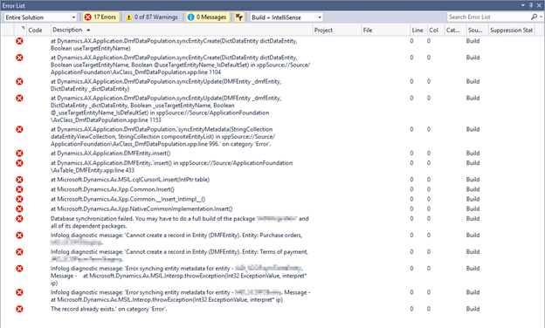
Lessons learned – build project
„Cannot create a record in Entity (DMFEntity)”

Slide 53
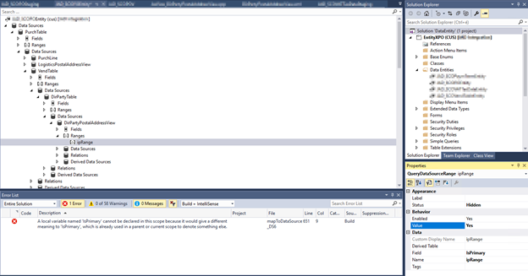
Lessons learned - IsPrimary
„Local variable named ‚isPrimary’ cannot be declared in this scope because it would give a different meaning to ‚IsPrimary’, which is already used in parent or current scope to define something else.”

Slide 54
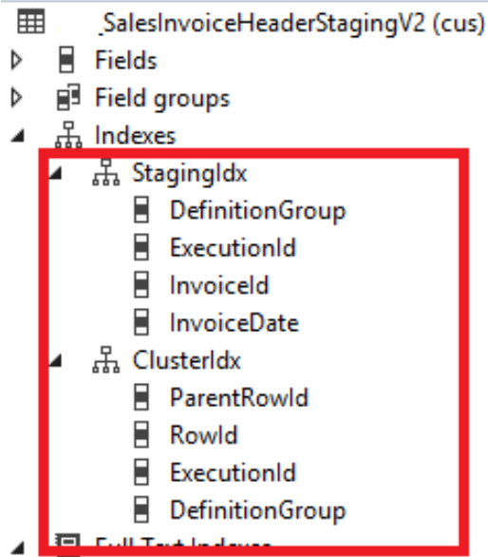
„The record already exisits” error when exporting composite
cluster & staging index?

Slide 55
AZURE DATA LAKE

Slide 56
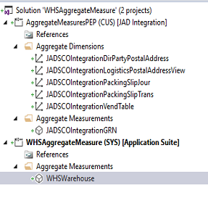
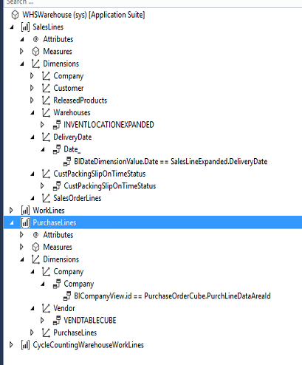
Aggregate measures and aggregate dimensions

Slide 57
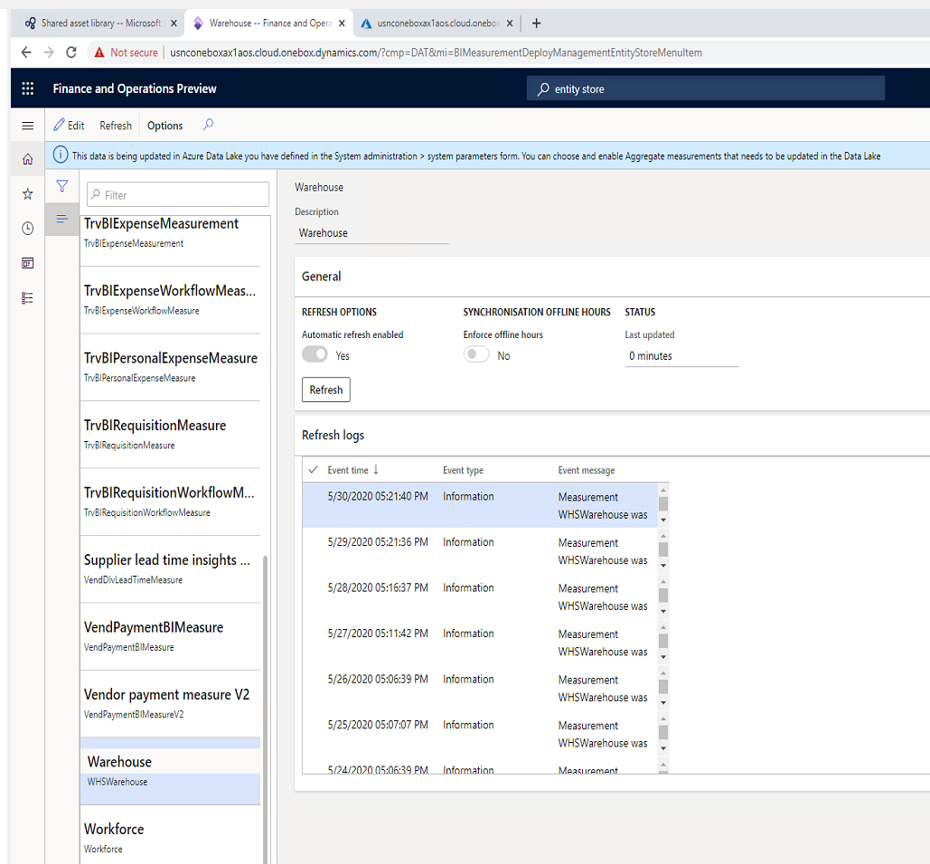
Entity store

Slide 58
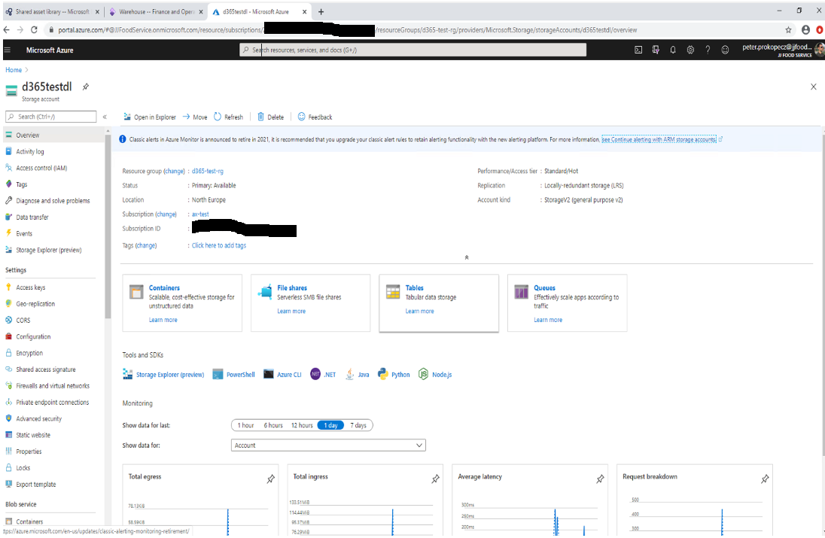
Make entity store available as a Data Lake
https://docs.microsoft.com/en-us/dynamics365/fin-ops-core/dev-itpro/data-entities/entity-store-data-lake

Slide 59
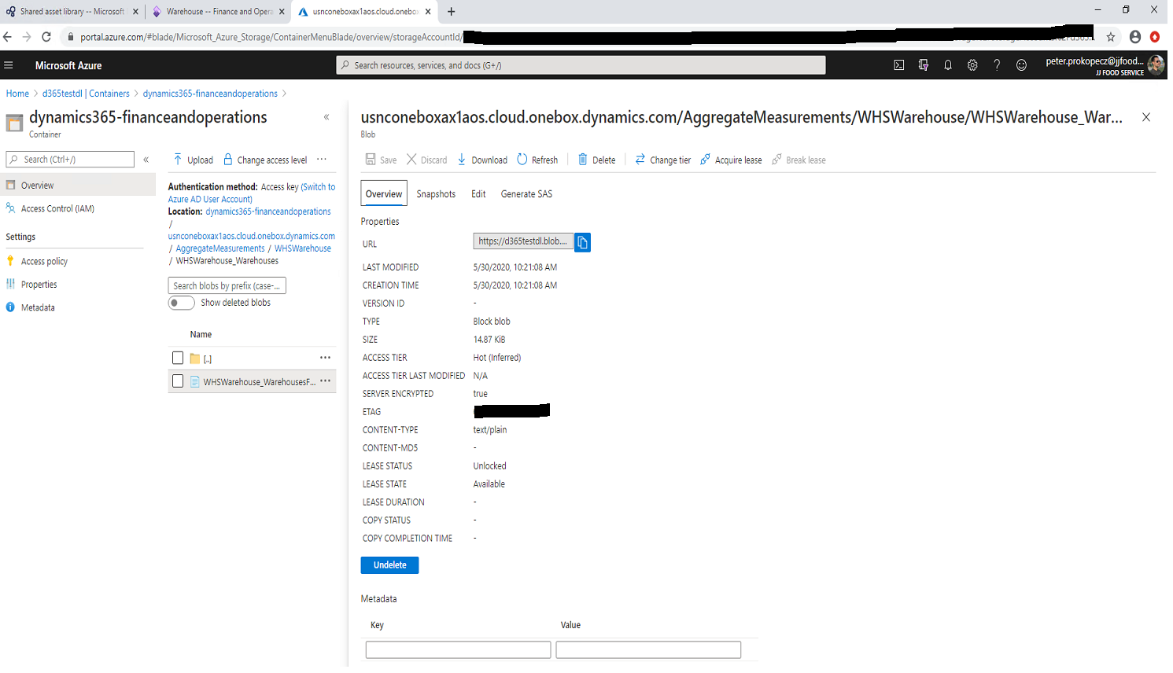
Data Lake - csv

Slide 60
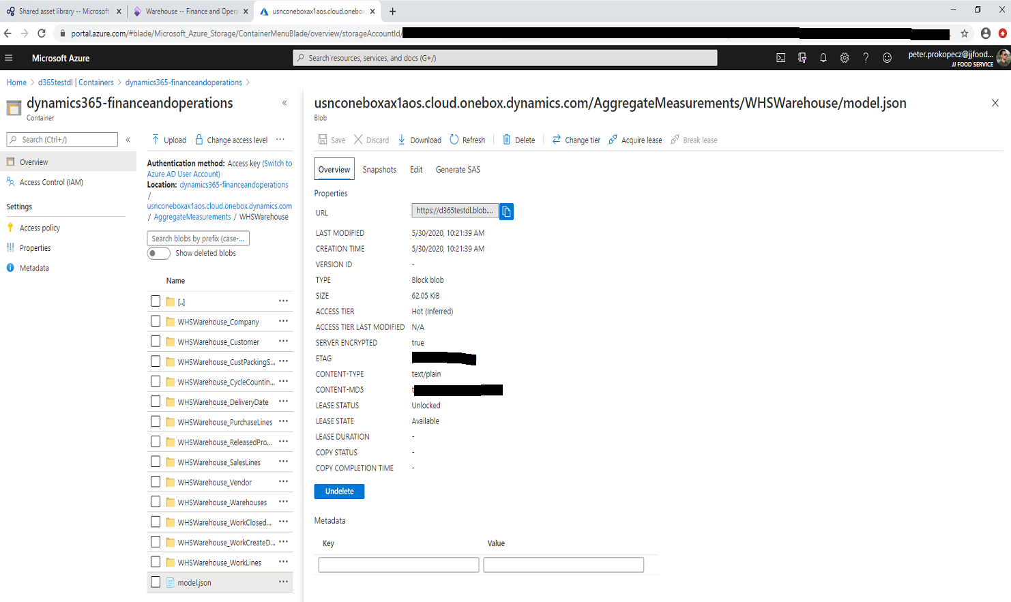
Data Lake – model.json

Slide 61
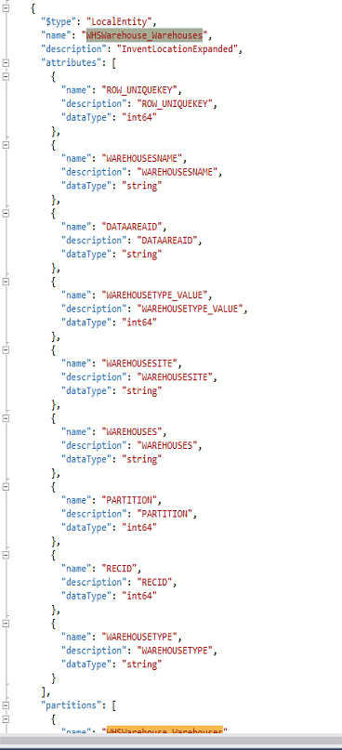
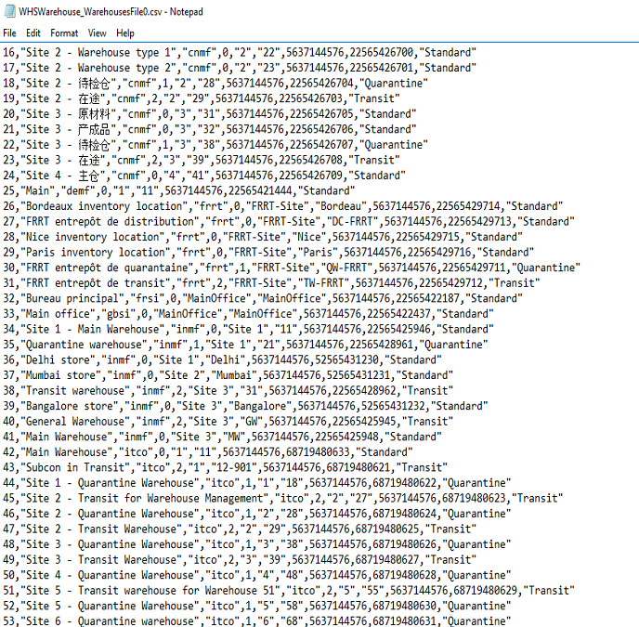
CSV files and Model.json

Slide 62
What have I talked about
Data entity overview
Entity demo
Data management
OData
Composite data entity
Lessons learned
Azure Data Lake

Slide 63
Thank you
Peter Prokopecz
info@daxvisionerp.com
DAXVision ERP Consulting Kft.
http://www.daxvisionerp.com/
https://www.linkedin.com/in/peter-prokopecz/

